Slide 1


Introduction to
Robotic Process Automation
ELDERLY CARE REMINDER BOT
Your Register No : 220701031
Name : ASHMITA R
Guide Name: Mrs. J. JINU SOPHIA
Designation :Assistant Professor(SG)
Department :Computer Science & Engineering

Slide 2
Abstract
The Elderly Care Reminder Bot is a robust automation solution designed to assist caregivers in managing reminders for elderly individuals, ensuring timely notifications for medications and doctor appointments. Built using UiPath, this bot utilizes an Excel sheet to store critical information such as scheduled times for tasks, the specific task details, and caregiver email addresses. The bot is programmed to extract the current time and compare it with the scheduled time. When the two match, an SMTP activity is triggered to send an email notification to the caregiver. In scenarios where the current time does not align with the schedule, the bot employs a delay activity, ensuring the system remains efficient and avoids unnecessary processing until the appropriate time is reached. This structured and reliable approach provides caregivers with peace of mind, reducing the risk of missed medications or appointments and contributing to the well-being of the elderly. The bot's ability to seamlessly integrate with Excel and automate reminders enhances caregiving efficiency, making it an indispensable tool for elderly care management.

Slide 3
Need for the Proposed System
The need for an Elderly Care Reminder Bot arises from the increasing challenges faced by the elderly in managing their daily routines and health requirements due to age-related cognitive decline, memory lapses, and physical limitations. With many seniors living independently or with limited access to caregivers, there is a growing demand for a reliable and accessible solution to ensure timely medication intake, adherence to medical appointments, and maintenance of a healthy lifestyle. The proposed system addresses these challenges by providing personalized, automated reminders and real-time support, reducing dependency on caregivers while enhancing safety, independence, and overall quality of life for the elderly

Slide 4
Advantages of the Proposed System
Timely Reminders: Ensures adherence to medication, appointments, and daily routines.
Independence: Promotes self-reliance by reducing dependency on caregivers.
User-Friendly: Accessible via voice, text, or app for ease of use.
Personalization: Tailors reminders based on individual schedules and needs.
Emergency Alerts: Notifies family or caregivers in case of missed tasks or emergencies.
Health Monitoring: Encourages adherence to healthy habits like hydration and exercise.
Peace of Mind: Provides reassurance to both elderly individuals and their families.
Cost-Effective: Reduces the need for constant caregiver supervision.

Slide 5
Literature Survey
Paper 1 : "A Smart Reminder System for Elderly Health Management”
Advantages:
Automates routine health reminders for medication and appointments.Easy integration with IoT devices like smartwatches and home assistants.Enhances communication between elderly individuals and caregivers.
Disadvantages:
Dependence on stable internet connectivity.Limited accessibility for those unfamiliar with technology.

Slide 6
Literature Survey
Paper-2 : “IoT- Based Real- Time Medicine Reminder and Dispenser for Elderly Patients”
Advantages:
Multimodal Reminders: Uses speaker, display, dispenser, and mobile notifications to remind users.
Automatic Dispensing: Ensures correct medication intake by dispensing the right dose.
Disadvantages:
Technology Dependency: Elderly users may struggle with setup or troubleshooting.
Connectivity Issues: Relies on stable internet, which may cause disruptions.

Slide 7
Main Objective
The main objective of the Elderly Care Reminder Bot is to provide timely, personalized reminders to elderly individuals for their daily routines, including medication, appointments, meals, and exercise, to promote independence, improve health management, and ensure safety. The bot aims to enhance the quality of life by reducing the reliance on caregivers and providing peace of mind to both seniors and their families.

Slide 8
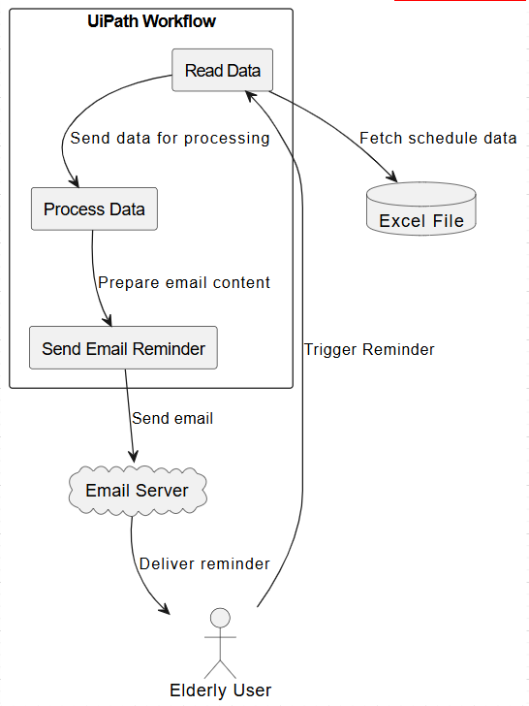
Architecture

Slide 9
System Requirements
Hardware:
Processor: Dual-Core or higher (Intel i3/AMD equivalent).
RAM: 4 GB (8 GB recommended).
Storage: 100 GB free space (SSD preferred).
Network: Stable internet connection (5 Mbps or higher).
Software:
OS: Windows 10/11, macOS, or Linux.
Tools: UiPath Studio, UiPath Robot, UiPath Orchestrator.
Data Source: Excel for schedules and reminders.

Slide 10
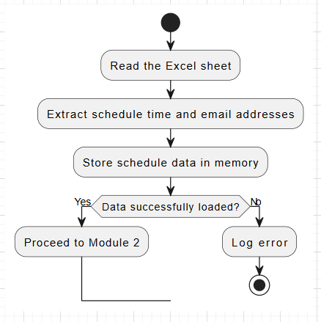
Functional Description-Module 1

Slide 11
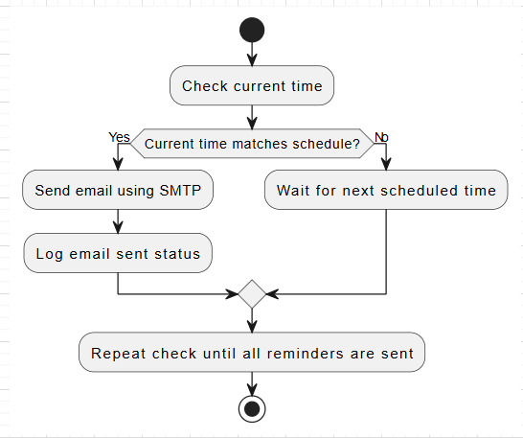
Functional Description-Module 2

Slide 12
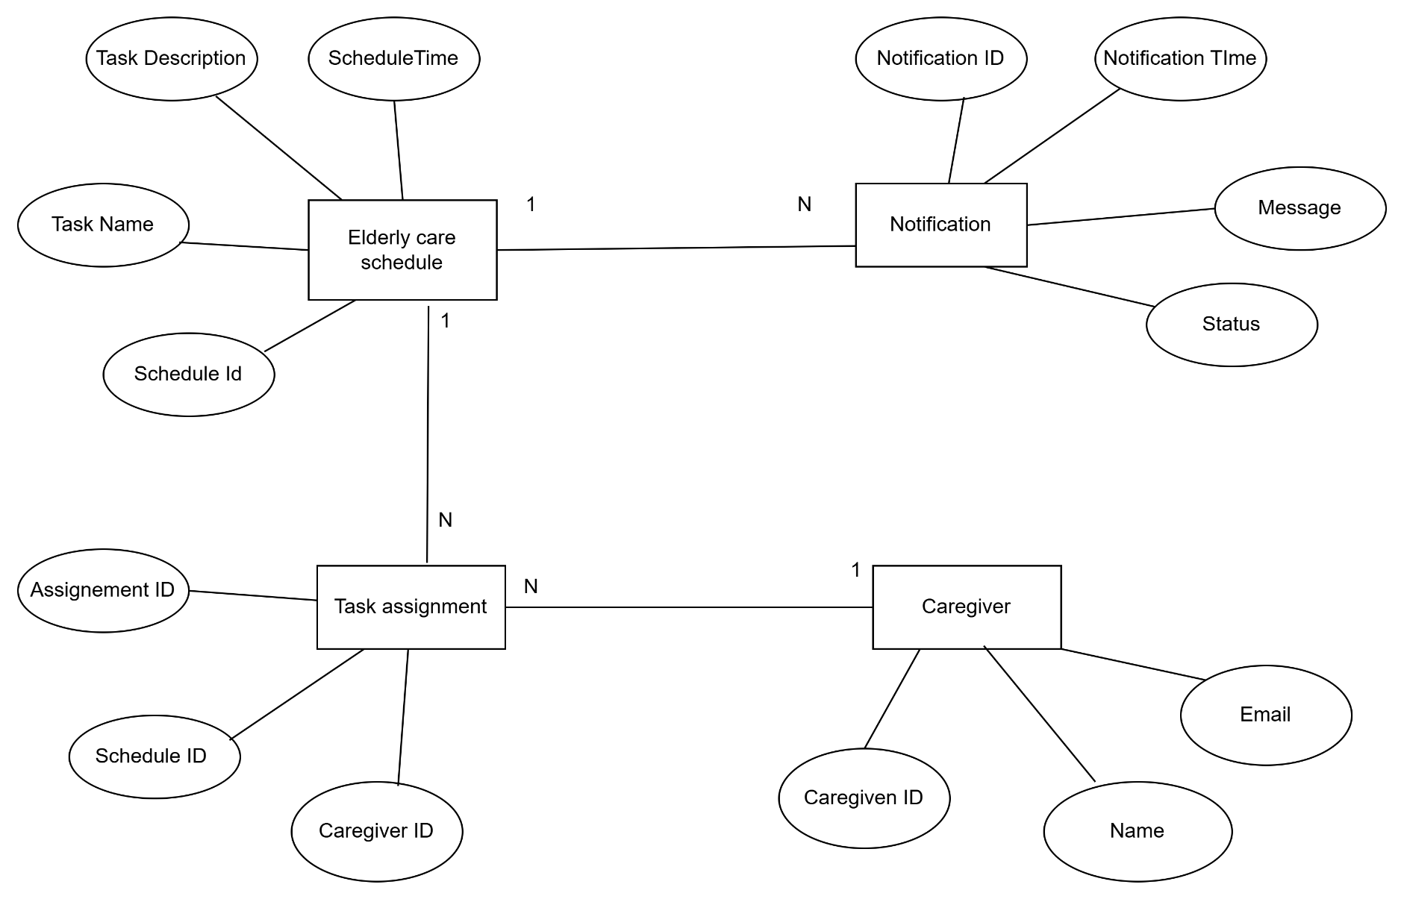
Table Design

Slide 13
Process Design
Start Process
Open Excel File
Read Data into DataTable
Loop Through Each Row
Extract Task, Time, and Email Information
Check Current Time Against Reminder Time
Send Email or Delay and Then Send Email
Repeat for All Rows
End Process

Slide 14
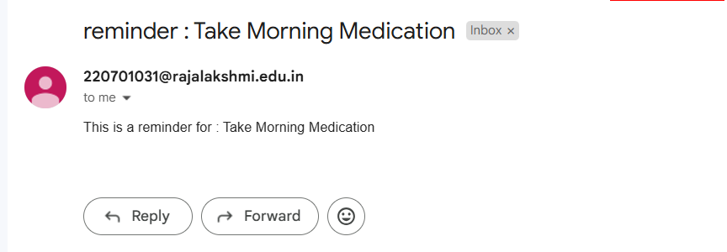
Implementation

Slide 15
Testing
Test Description: A brief description of what is being tested (e.g., Verify that a reminder is set correctly at 10:00 AM).
Input: The data or action being tested (e.g., User sets a reminder for 10:00 AM for taking medication).
Expected Output: What should happen if the system works correctly (e.g., A reminder notification should be sent at 10:00 AM).
Actual Output: What actually happens during the test.

Slide 16
Conclusions
In conclusion, the Elderly Care Reminder Bot effectively addresses the needs of elderly individuals by providing an easy-to-use system for managing important reminders. With its simple interface, real-time notifications, and secure handling of user data, the bot helps users stay on track with medication, appointments, and daily activities. The bot has been thoroughly tested and refined based on user feedback, making it a valuable tool for enhancing the independence and well-being of elderly individuals. Future improvements could include voice commands and additional integrations, further expanding its capabilities.

Slide 17
Future Enhancement
Voice Command Integration
Integration with Wearable Devices
AI-Powered Health Reminders
Emergency Alert System
Multi-language Support
Medication Tracking and Refill Reminder

Slide 18
IEEE Paper
https://ieeexplore.ieee.org/stamp/stamp.jsp?tp=&arnumber=10047781&isnumber=10046669
https://ieeexplore.ieee.org/stamp/stamp.jsp?tp=&arnumber=10691910&isnumber=10691903

Slide 19
References
AI-Powered Robotics for Elderly Care: Enhancing Assistance and Companionship
Source: AI-Powered Robotics for Elderly Care: Enhancing Assistance and Companionship
Robots for Elderly Care in the Home: A Landscape Analysis
Source: Robots for Elderly Care in the Home: A Landscape Analysis
Robots for Elderly Care: Review, Multi-Criteria Optimization, and Future Directions
Source: Robots for Elderly Care: Review, Multi-Criteria Optimization, and Future Directions
Exploring Human-Robot Interaction with the Elderly: Results from a Ten-Week Case Study in a Care Home
Source: Exploring Human-Robot Interaction with the Elderly: Results from a Ten-Week Case Study in a Care Home
Mapping Emerging Technologies in Aged Care: Results from an In-Depth Study
Source: Mapping Emerging Technologies in Aged Care: Results from an In-Depth Study

Slide 20
Thank You

